Slide 1


Data-Driven Approach to Predict Hotel Reservation Cancellations
21st July, 2023
Created by
Neural Nexus
Group-9

Slide 2







Our
Team -
Neural Nexus
Bhanwar Sachdeva (6780526)
Nattabhat Sirisoonthorn (6780137)
Sagar Saxena (6781347)
Thensih Kaithavalappil Abu (6782614)

Slide 3


Agenda
Problem Statement & Objectives
Data Pre-processing
Exploratory Data Analysis
Feature Selection
Model Evaluation
Return of Investment
Recommendations
Appendix

Slide 4




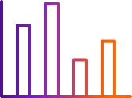




Opportunity Statement &
Objectives
A substantial number of hotel reservations are lost due to cancellation and lack of accurate cancellation prediction hinders effective decision making leading to following challenges.
Dataset : Hotel Reservations(Hotel reservations dataset, 2023b)
Datapoints : 36k observation & 19 attributes
Source : Kaggle
https://www.kaggle.com/datasets/ahsan81/hotel-reservations-classification-dataset
1
3
Resource Allocation Challenges
Minimize Monetary Losses
Customer Retention Initiatives
Revenue Losses
Challenges
Identification of High-Risk Reservations
Flexible Booking Opportunities
Capacity Optimization
Objectives
4
2

Slide 5
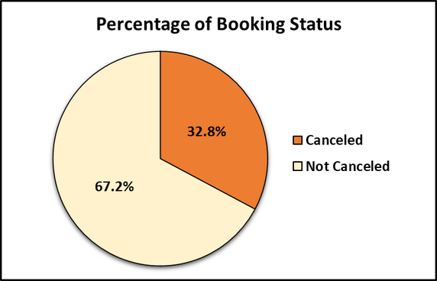
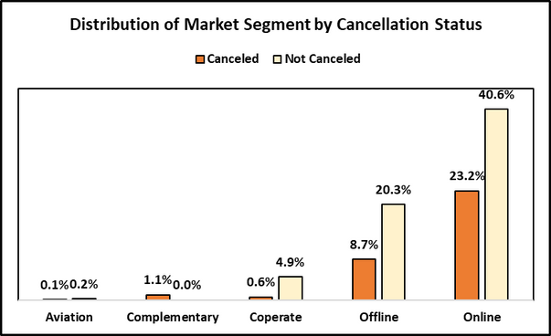
Data Pre-processing
PROCESS | DESCRIPTION
Data Summary | summary of characteristics and statistical value of dataset
Missing & Duplicate Value | not detected
Feature Engineering | create new Arrival_date column
Invalid Value | 32 rows are removed due to invalid date
Outliers | found in lead_time and avg_price_per_room, they remain in dataset
Data Distribution | identify relation between target field and other fields

Slide 6
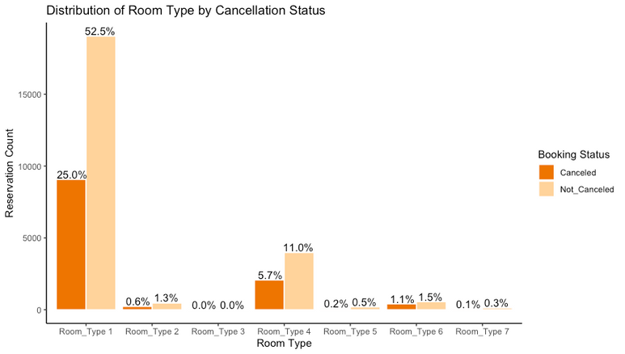
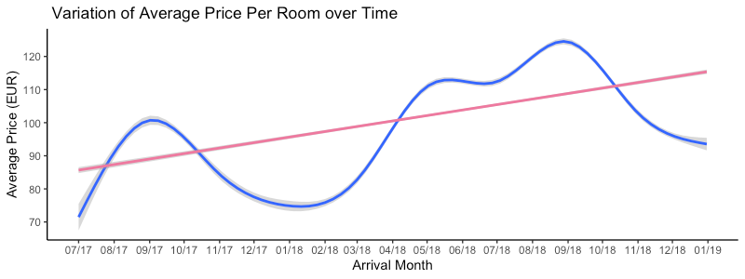
Exploratory Data Analysis
Room_Type_1 is the cheaper option. Hence, High number of reservations
Room_Type_7 is the most expensive. Hence, Minimal reservations.
Increase in average room price over time.
Seasonal Impact - Lower prices in Jan-Feb , Higher price is Aug-sept

Slide 7
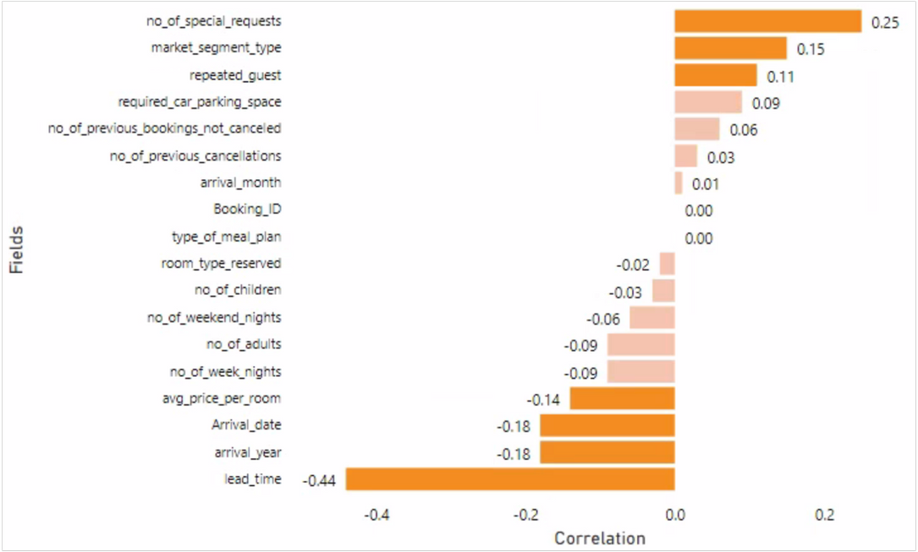
Feature Selection
Relationship with Target Field:
Negatively correlated - avg_price_per_room, lead_time and Arrivale_date
Positivley correlated - no_of_special_requests, market_segment_type and repeated_guests

Slide 8
Model Evaluation
Support Vector Machine
Logistic
Regression
K Nearest
Neighbors
Random
Forest
Test data proportion
40%
30%
30%
40%
Performance Improvement methods used
Substituting kernel functions (rbfdot)
Adding cost value to violated points (c = 5)
Adding Non-linear Relationships
Adding Interaction Effects
Transformation
Normalization
Cross validation
k value = 9
Sets minimum number of terminal nodes(leaves) in each decision tree
Accuracy | 84.24 | 80.71 | 86.43 | 87.27
Kappa | 62.65 | 54.22 | 68.62 | 70.45
Sensitivity | 67.69 | 62.03 | 75.61 | 76.17
Specificity | 92.30 | 89.82 | 91.71 | 92.68
Precision | 81.09 | 74.81 | 81.64 | 83.54
Considered canceled reservation as positive

Slide 9
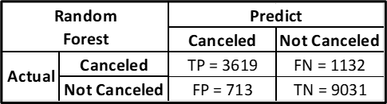

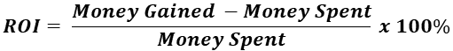
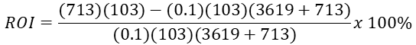
Return on Investment
As per Random Forest Algorithm, we will be able to retain 713 customers with marketing efforts when reaching out to all the predicted cancellations i.e. 4332 (TP+FP)
Money Gained:
Revenue from "Not cancelled" Guests (average price per room = € 103)
Money Spent: Marketing Cost (10% of the average price per room) [2]
ROI[5] = 64.59%

Slide 10
Conclusions
"Random Forest" is the most suitable classification algorithm with 87% accuracy.
We can achieve 65% return on investment on our marketing expenditure.
Able to retain 17% customers (predicted as cancelled) with the marketing efforts.
Recommendations
We recommend that hotels can try to retain the customers predicted as cancelling the reservations by providing promotional discounts and offers.
Hotels can invest higher in marketing, specially during peak season of August and September to gain higher ROI[3].
Online bookings yield highest revenue hence digital marketing initiatives can lead to higher profitability[4]

Slide 11
References
Hotel reservations dataset (2023). Available at: https://www.kaggle.com/datasets/ahsan81/hotel-reservations-classification-dataset.
What marketing budgets look like in 2022 (no date). Available at: https://www.gartner.com/en/articles/what-marketing-budgets-look-like-in-2022.
Firebird Tours ® (2023) When to Go to Europe: Peak Season vs Off-Season. Available at: https://www.firebirdtours.com/blog/when-go-europe-peak-season-vs-season.
Statista (no date) Hotels - Worldwide | Statista market forecast. Available at: https://www.statista.com/outlook/mmo/travel-tourism/hotels/worldwide.
Gillis, A.S. (2021) “ROI (return on investment),” CIO [Preprint]. Available at: https://www.techtarget.com/searchcio/definition/ROI.
Lantz, Brett. Machine Learning with R - Second Edition : Discover How to Build Machine Learning Algorithms, Prepare Data, and Dig Deep into Data Prediction Techniques with R, Packt Publishing, Limited, 2015. ProQuest Ebook Central, http://ebookcentral.proquest.com/lib/surrey/detail.action?docID=2122139.

Slide 12

Thank You

Slide 13
Appendix
Performance Indicators for Naïve Bayes and Neural Network Algorithms
 | Naïve Bayes | Neural Network
Test data proportion | 50% | 30%
Accuracy | 71.9% | 73%
Kappa | 43.5% | 33.4%
Sensitivity | 54.8% | 62.4%
Specificity | 88.7% | 76.2%
Precision | 82.5% | 44.3%
R Scripts of individual team members.
KNN and Neural Network
Decision Tree and random Forest
Logistic Regression
SVM and Naïve Bayes

